Slide 1

Discrete Structures
(Software Engineering)
Instructor
Dr. Bakhtawar

Slide 2
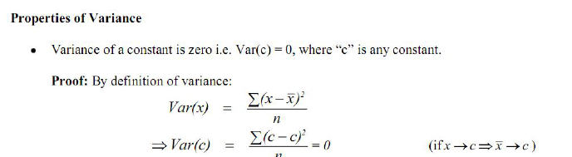
PROPERTIES Variance

Slide 3

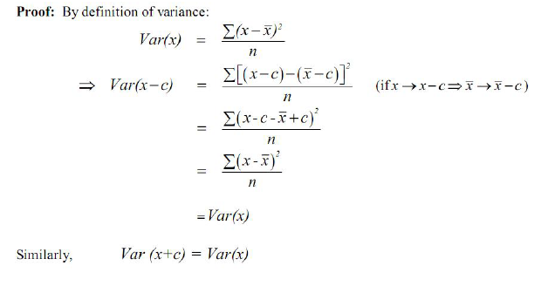
PROPERTIES Variance

Slide 4
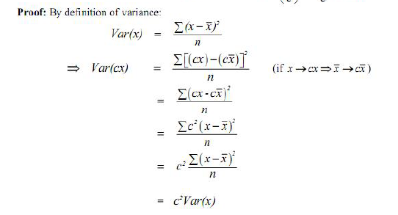
PROPERTIES Variance

Slide 5
Sets
A set is an unordered collection of objects.
The objects in a set are called the elements, or members, of the set.
A set is said to contain its elements.
Example:
Z is the set of integers.
Cities in the Pakistan: {Lahore, Karachi, Islamabad,.. }

Slide 6
Sets
Properties:
Order does not matter
{1, 2, 3, 4, 5} is equivalent to {3, 5, 2, 4, 1}
Sets do not have duplicate elements
Consider the list of students in this class
It does not make sense to list somebody twice

Slide 7
Set membership
a is an element of the set A, denoted by a ∈ A.
a is not an element of the set A, denoted by a ∉ A.

Slide 8
Examples
Set M: Students taking Discrete Mathematics course.
Assume Hassan is taking Discrete Mathematics course and Saad is not taking Discrete Mathematics course.
Hassan ∈ M
Saad∉ M

Slide 9
Examples
The set V of all vowels in the English alphabet can be written as V = {a, e, i, o, u}
V: {a,e,i,o,u}
a ∈ V
b ∉ V

Slide 10
Examples
The set O of odd positive integers less than 10 can be expressed by O = {1, 3, 5, 7, 9}.
O: {1, 3, 5, 7, 9}
5 ∈ O
10 ∉ O

Slide 11
Set builder
Characterize all elements in the set by stating properties they must have.
Example:
E= {x | x is an Even positive integer less than 10}
E= {x ∈ 𝒁+ | x is even and x<10}
E= {2,4,6,8}
The vertical bar means “such that”

Slide 12
Some useful sets
Set of natural numbers
𝐍 = {1,2,3,…}
Set of integers
𝐙 = {…,-2,-1,0,1,2,…}
Set of positive integers
𝐙+ = {1,2,3,…}
Set of rational numbers
𝐐 = {p/q | p ∈ 𝐙, q ∈ 𝐙, and q ≠ 0}
Set of real numbers
𝐑

Slide 13
Equality of sets
Let A and B be two sets.
A and B are equal if and only if they have the same elements, denoted by A = B.
{1,2,3} and {3,2,1}
{1,2,3} = {3,2,1}
𝐙+ and {-1,1,2,…}
𝐙+≠ {-1,1,2,…}

Slide 14
Empty set
There is a special set that has no elements. This set is called the empty set or null set, and is denoted by ∅.
The empty set can also be denoted by { } (that is, we represent the empty set with a pair of braces that encloses all the elements in this set).

Slide 15
Empty set
Example:
S = {x | x ∈ 𝑍+ and x < 0 }
S = { } = Ø
A set that has no elements called empty set, or null set.
Ø and { }
Ø ≠ {Ø}

Slide 16
singleton set
A set with one element is called a singleton set. A common error is to confuse the empty set ∅ with the set {∅}, which is a singleton set.

Slide 17
Subset
Let A and B be sets.
A is a subset of B if and only if every element of A is also an element of B, denoted by A ⊆ B.

Slide 18
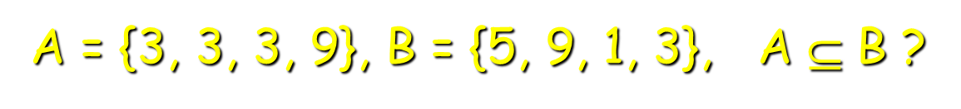
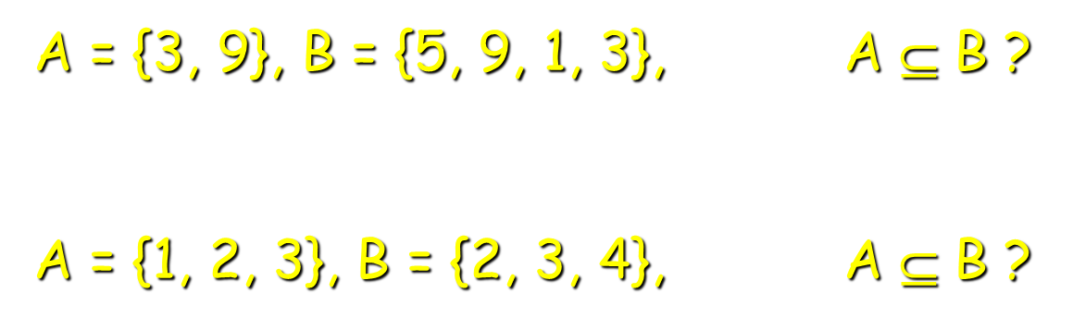
Subset(example)
True
True
False

Slide 19
Subset(examples)
A = {x | x ∈ 𝐙+ and x<10}
A = {1,2,3,4,5,6,7,8,9}
B = {x | x ∈ 𝐙+ , x is even and x<10}
B = {2,4,6,8}
B ⊆ A

Slide 20
Proper Subset
Let A and B be sets.
A is a proper subset of B if and only if A is a subset of B but A ≠B, denoted A ⊂ B.

Slide 21
Proper Subset
If S is a subset of A, and S is not equal to A, then S is a proper subset of A
Let A = {0, 1, 2, 3, 4, 5} and S = {1, 2, 3}
S is not equal to A, and S is a proper subset of A
Let Q = {4, 5, 6}. Q is neither a subset of A nor a proper subset of A
The difference between “subset” and “proper subset” is like the difference between “less than or equal to” and “less than” for numbers

Slide 22
Is ∅∈ {1,2,3}? No!
Is ∅ ⊆ {∅,1,2,3}? Yes!
Is ∅∈ {∅,1,2,3}? Yes

Slide 23
Size of Sets
Let S be a set.
The cardinality of a set is the number of elements in a set S
Cardinality of S, denoted by |S|.

Slide 24
Size of Sets
Find cardinality of following sets.
A = {x | x ∈ 𝐙+ , x is odd and x<10}
A = {1,3,5,7,9}
|A| = 5
C = {Ø}
|C| = 1
R
R is infinite

Slide 25
Size of Sets
A = {Mercedes, BMW, Porsche},
|A| = 3
E = { x∈N | x ≥ 7000 }
|E| = Infinite.
B = Ø
|B| = 0

Slide 26
Cartesian product
Let A and B be sets.
The Cartesian product of A and B, denoted by A x B, is the set of all ordered pairs (a,b), where a ∈ A and b ∈ B.
AxB = {(a,b) | a ∈ A ˄ b ∈ B}

Slide 27
Cartesian product(Example)
A = {0,1,2}, B = {a,b}
Are A x B and B x A equal?
Solution:
A x B = {(0,a),(0,b),(1,a),(1,b),(2,a),(2,b)}
B x A = {(a,0),(a,1),(a,2),(b,0),(b,1),(b,2)}
So, A x B ≠ B x A.

Slide 28
Cartesian product(example)
A = {a, b}, B = {1}, C = {x, y, z}
A x B x C = ?
Solution:
A x B x C = {(a,1,x), (a,1,y), (a,1,z), (b,1,x), (b,1,y), (b,1,z)}

Slide 29
Set operations
Two sets can be combined in many different ways.
Set operations can be used to combine sets.

Slide 30
Union
Let A and B be sets.
The union of A and B, denoted by A ⋃ B, is the set containing those elements that are either in A or in B, or in both.
A ⋃ B = {x | x ∈ A ˅ x ∈ B}

Slide 31
Union(example)
Let A = {1,2,3}
B = {2,4,6,8}
A ⋃ B = {1,2,3,4,6,8}
Let A = {x | x ∈ Z ˄ x is even}
B = {x |x ∈ Z ˄ x is odd}
A ⋃ B = Z= {Even and odd}

Slide 32
Intersection
Let A and B be sets.
The intersection of A and B, denoted by A ∩ B, is the set containing those elements in both A and B.
A ∩ B = {x | x ∈ A ˄ x ∈ B}

Slide 33
Intersection(example)
Let A = {1,2,3}
B = {2,4,6,8}
A ∩ B = { 2 }
Let A = Z
B = {x |x ∈ Z ˄ x is odd}
A ∩ B = {x |x ∈ Z ˄ x is odd}

Slide 34
Disjoint sets
Two sets are called disjoint if their intersection is empty.
Let A = {x | x ∈ Z ˄ x is even}
B = {x |x ∈ Z ˄ x is odd}
A ∩ B = Ø

Slide 35
difference
Let A and B be sets.
The difference of A and B, denoted by A - B, is the set containing those elements that are in A but not in B.
A - B = {x | x ∈ A ˄ x ∉ B}

Slide 36
difference
Let A = {1,2,3}, B = {2,4}
A – B = {1,3}
Let A = Z, B = { x | x ∈ Z ˄ x is odd }
A – B = { x | x ∈ Z ˄ x is even }

Slide 37

Complement
Let U be the universal set and A be a set.
The complement of A, denoted by A , is the complement of A with respect to U (which is U - A).

Slide 38
Complement(example)
Let A = { a, b, c, d } and U is the set of English alphabet
A = { e, f, g, h, i, j, k, l, m, n, o, p, q, r, s, t, u, v, w, x, y, z }
Let A = { x | x ∈ Z ˄ x is odd } and U is Z
A = { x | x ∈ Z ˄ x is even }

Slide 39
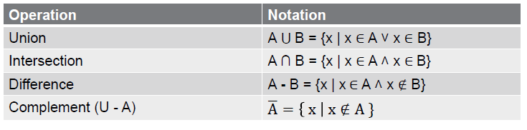
Summary set operations

Slide 40
Set identities or Algebra on sets
A ∪ ∅ = A Identity Law
A ∩ U = A
A ∪ U = U Domination Law
A ∩ ∅ = ∅
A ∪ A = A Idempotent Law
A ∩ A = A

Slide 41
Set identities or Algebra on sets
A ∪ B = B ∪ A Commutative Law
A ∩ B = B ∩ A

Slide 42
Set identities or Algebra on sets
A ∪ (B ∪ C) = (A ∪ B) ∪ C Associative Law
A ∩ (B ∩ C) = (A ∩ B) ∩ C
A ∪(A ∩ B) = A Absorption Law
A ∩(A ∪ B) = A

Slide 43
Set identities or Algebra on sets
A ∪ B = A ∩ B De Morgan’s Law A ∩ B = A ∪ B
A ∩ (B ∪ C) = (A ∩ B) ∪ (A ∩ C) Distributive
A ∪ (B ∩ C) = (A ∪ B) ∩ (A ∪ C) Law

Slide 44
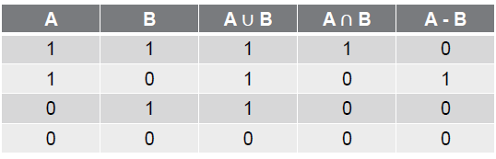
Proof by truth tables

Slide 45
Proof by truth tables
Truth table by Distributive Law
A ∩ (B ∪ C) = (A ∩ B) ∪ (A ∩ C)
A ∪ (B ∩ C) = (A ∪ B) ∩ (A ∪ C)

Slide 46
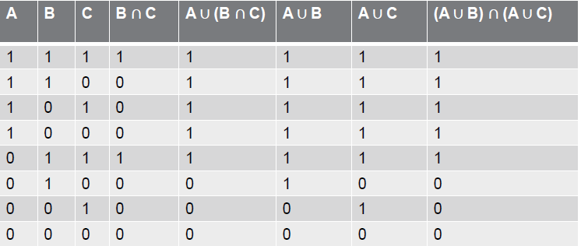
Proof by truth tables

Slide 47
Thank you!

